Slide 1





Slide 2


Slide 3


Slide 4


Slide 5



Slide 6
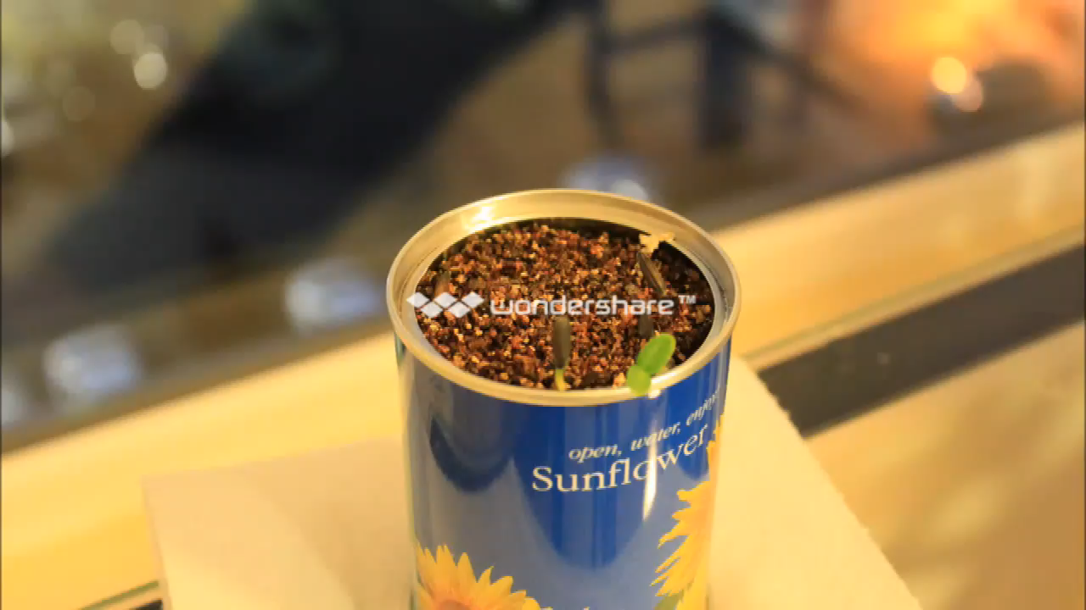

Slide 7






Slide 8



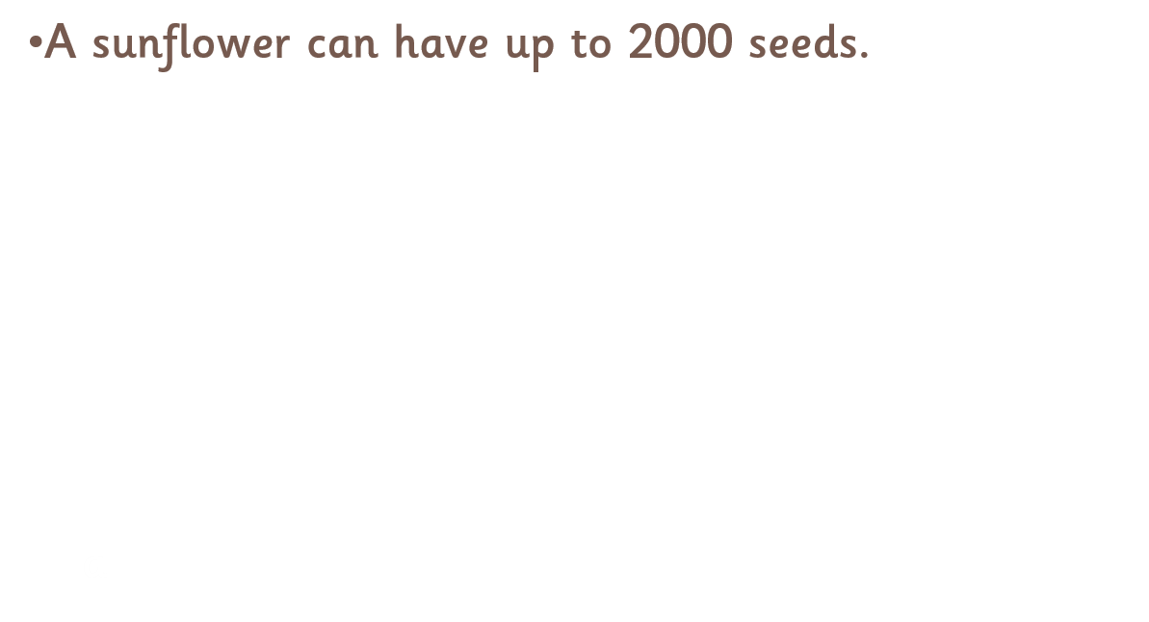

Slide 9

THE END

